Slide 1
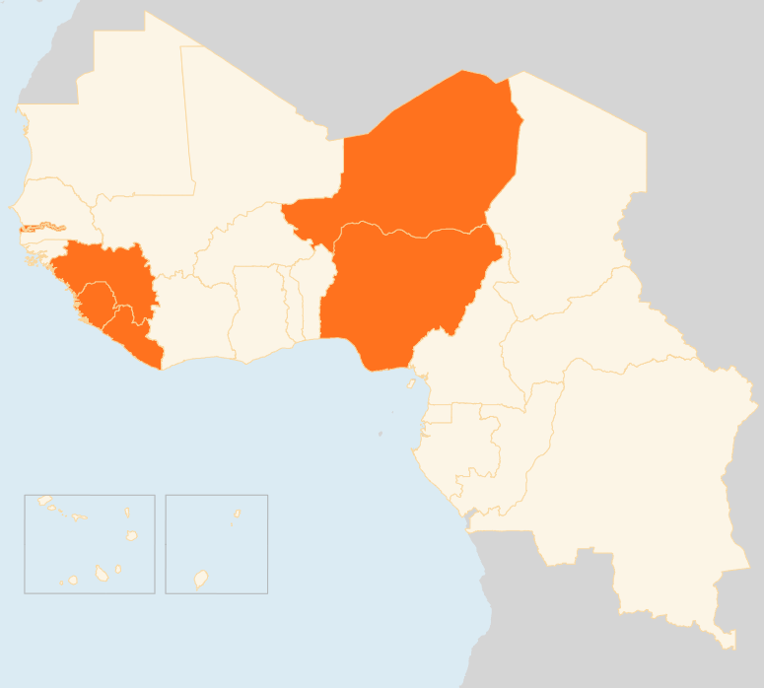


21 - 27 April 2015
GUINEA
11 JAILED FOR MURDERING HEALTH WORKERS
On 22 April, 11 people charged with the murder of eight Ebola health workers were sentenced to life in prison. Fifteen others were acquitted over the attack on the health workers and a journalist in September 2014 in Womey town in the southern Nzérékoré Prefecture. Hostility towards health workers, misconceptions about, and fear of Ebola have been some of the hurdles in curbing the spread of the virus in Guinea.
LIBERIA
0 EBOLA CASES IN 37 DAYS
As of 27 April, Liberia had gone for 29 days without reporting any Ebola infection since the last patient was buried, and 37 days since the last confirmed case. The country, however, remains at risk due to the ongoing transmissions in Guinea and Sierra Leone. Border monitoring and surveillance is ongoing. Humanitarian actors are working on appropriate public messaging on recommended good behaviour and practices to avoid possible complacency. Partners continue to stress the importance of community participation in building effective long-term surveillance and response capacity.
NIGER
129 KILLED IN MENINGITIS OUTBREAK
An outbreak of meningitis that erupted in January had killed 129 people and infected 1,150 others as of 22 April, when all schools in and around the capital Niamey were closed. All the country’s regions, with the exception of the southern Diffa Region have been affected. A mass vaccination campaign is underway. The last such outbreak was reported in 2011.
NIGERIA
IDPs BEGIN RETURNING DESPITE INSECURITY
More and more IDPs in north-eastern Nigeria are spontaneously returning to their areas of origin despite persistent insecurity and critical lack of access to basic services. In Borno state, the State Emergency Management Authority has reported the relocation and resettlement of 801 IDPs (128 men, 168 women and 505 children) from the Pompomari Primary School IDP camp in Damaturu to Adamawa, Borno, Gombe and Yobe states. The total number remaining in the camp is 3,304.
REGIONAL / EBOLA VIRUS DISEASE
RECENT DECLINE IN CASES HALTS
In the week leading up to 19 April, a total of 33 confirmed cases were reported in Guinea (21) and Sierra Leone (12). Liberia continues to report no infections since the death of the last Ebola patient on 27 March. A drop in cases seen in the past three weeks has halted. In total, 26,044 confirmed, probable and suspected cases, and 10,808 deaths have been reported in the three countries.
GUINEA
NIGER
11
JAILED FOR MURDERING HEALTH WORKERS
129
KILLED IN MENINGITIS OUTBREAK
NIGERIA
IDPs START RETURNING DESPITE INSECURITY
LIBERIA
REGIONAL / EVD
0
EBOLA INFECTIONS IN 37 DAYS
33
CASES IN GUINEA AND SIERRA LEONE
Creation date: 28 April 2014
Map data sources: UNCS, DevInfo, OCHA.
The boundaries and names shown and the designations used on this map do not imply official endorsement or acceptance by the United Nations

